Slide 1
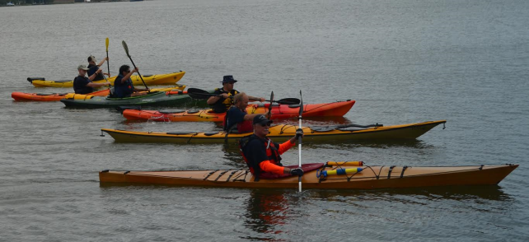
AUXILIARY PADDLE CRAFT (AUXPAD) Underway
Don Goff
Senior Advisor, Paddlecraft Safety
22 Jan 2017

Slide 2
References
COMDTINST 16794.11 12 MAR 2015
USCG Fifth District Auxiliary Paddle Craft (AUXPAD) Program Process Guide, DPA PG-05-01, Mar 2016

Slide 3
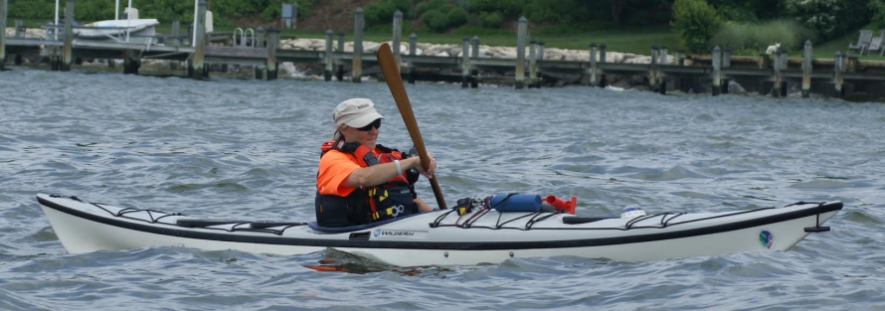
Agenda
The Need
AUXPAD Missions
Getting Started
AUXPAD Qualifiers Training Requirements
AUXPAD Operators Training Requirements
Offer-For-Use
Additional Equipment Required, D5
Additional Requirements, D5
AOMS

Slide 4
“Boats in Aisle Five”
Most boats are now sold by retailers who are not paddlers
Most boats are sold without any instruction or guidance
Notes:
In the past, would-be paddlers often went to specialty stores to get information and advice from retailers who were paddlers themselves.
The majority of boats sold now come from general merchandisers and “big box” outlets whose staff are not particularly knowledgeable about the details of the sport.
In addition, the safety equipment offered for sale may be generic rather than specific to the location.

Slide 5
Registered Vessels and Deaths 1962-2014
Notes:
Since the early 1960’s when the Coast Guard began tracking recreational boating accidents, overall, fatalities have come down both in percentage and real terms for power boats.
The number of registered vessels has increased. (green line)
A linear projection of fatalities using the 1962 numbers shows nearly 3000 deaths could have been expected in 2010 (red line)
Public awareness and PE classes have contributed to a dramatic reduction in the actual outcome (blue line)
Registered Vessels and Deaths 1962-2014

Slide 6
The Problem
Fatalities

Slide 7
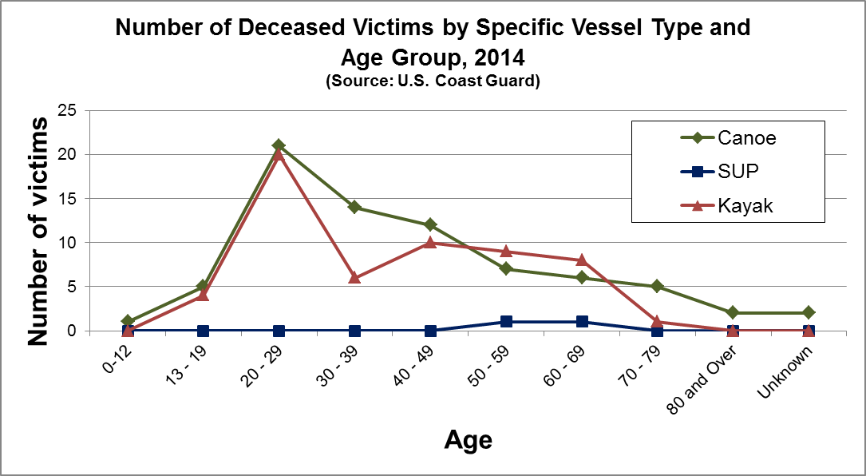
Notes:
We have a done a fair job protecting youth, according to these figures from 2014.
We might expect young men, especially those using alcohol, to have a relatively high rate.
But these figures show that paddlers over age 50 are dying as well as younger paddlers.

Slide 8
AUXPAD’s Missions
Extend boating safety outreach
Promote life jacket wear
Promote operator compliance with Coast Guard required safety equipment within the paddle craft community
AUXPAD Afloat Outreach activities places qualified AUXPAD operators in direct contact with recreational paddle craft users on the water.
Promotes paddle craft RBS via personal example and affords an opportunity for Auxiliarists to assimilate with the paddle craft community and develop networks to promote boating safety.
RBS—not operational!

Slide 9
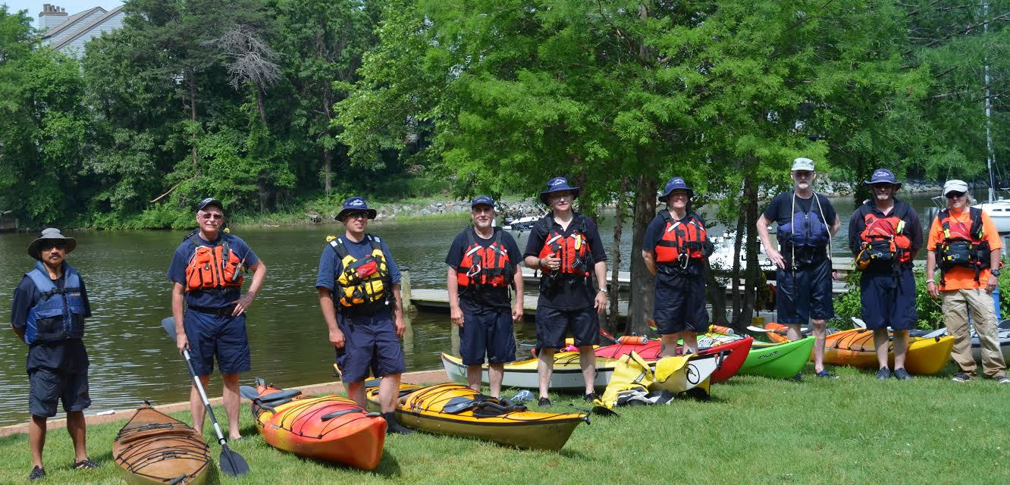
Current Resources

Slide 10
Getting Started
Review COMDINST documents and determine approach
District must have at least 2 AUXPAD Qualifiers
May coordinate with the National Senior Advisor to NACO for Paddlecraft Safety for info, access to SMEs and to get a negotiated fixed price opportunity with ACA instructors

Slide 11
AUXPAD Qualifiers Training Requirements
ACA Instructor course certificates for:
L-1 Introduction to Kayak
L-2 Sit on Top AND
L-2 Touring Kayak
Semi-annual currency maintenance
3rd year recertification (in conjunction with the corresponding Semi-Annual Skills Assessment)

Slide 12
AUXPAD Operators Training Requirements
ACA course certificates or AQ endorsed ACA skills Assessment for L-1 Introduction to Kayak AND L-2 Sit on Top OR Touring Kayak.
Semi-annual currency maintenance at beginning and end of season
3rd year recertification (in conjunction with the corresponding Semi-Annual Skills Assessment)

Slide 13
L-1 Introduction to Kayaking Carries
Kayak carries
•Loading and unloading, racks, tie down
•Demo using straps or line and knots to secure craft to vehicle
•Launching/landing from land or docks
•Kayak Trim
•Posture, rocking and balance
•Basic Terminology
•Outfitting
•Land & water etiquette

Slide 14
L-1 Rescues
Rescue
All participants are to be asked to demonstrate a controlled capsize and an appropriate rescue.
•Water comfort and confidence
•Controlled capsize / wet exit
•Swim the boat to shore (short distance)
•Emptying a kayak
•Deep water exit / re-entry
•Assisted Rescues

Slide 15
L-1 Strokes
•Forward
•Back (stopping)
•Draw
•Sculling draw/brace
•Sweep (including Stern Draw)
•Reverse Sweep
•Rudder
•Low brace to avoid capsize

Slide 16
L-2 Essentials of Kayak Touring
Safety & Rescue:
•Exercising Judgment, Safety as a mind-set, etc
•Cold Water Shock / Hypothermia: HELP/Huddle, clothing
•Dehydration/ hyperthermia: hydration, clothing
•Hazards: wind, waves, weather, current, rocks, bridges, piers, dams, strainers, traffic
•Paddling as a group
•Signaling
•Interactions/ Sharing water with non powered and powered traffic
•Emergency procedures

Slide 17
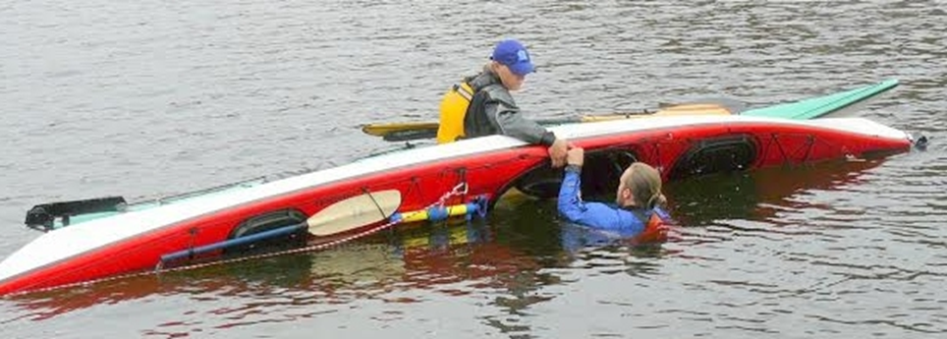
L-2 Rescues & Maneuvers
•Rescue sequence: RETHROG
•Rescue priorities: people, boats, gear
•Demonstrate/participate: T-X rescue
•Deep-water re-entries, assisted and solo, with sling, scooping
•Boat assisted rescue, assisting a tired swimmer (pushing or pulling to shore)
•Towing or bulldozing a capsized boat
Maneuvers:
•Paddling in a reasonably straight line
•Spins
•Stopping
•Moving Abeam

Slide 18
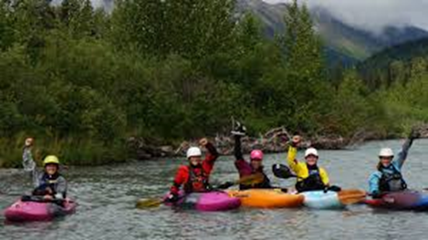
L-2 Strokes
•Forward
•Back (stopping)
•Draw
•Sculling draw/brace
•Sweep (including Stern Draw)
•Reverse Sweep
•Rudder
•Low / High Brace

Slide 19
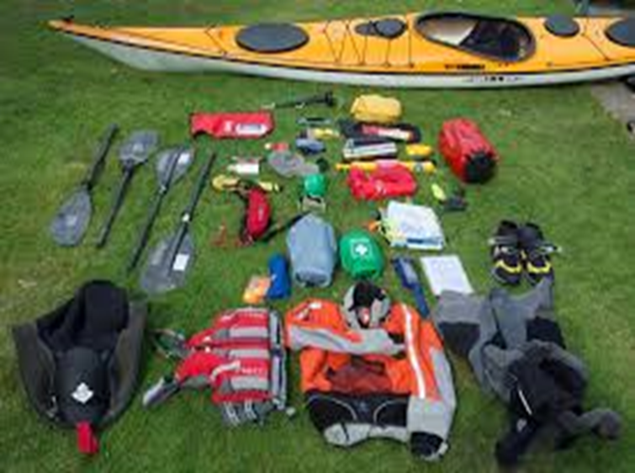
Offer-For-Use
Use Form 7012a for the vessel examination
In D5, use the D5 form appended to the Process Guide

Slide 20
D-5 Additional Equipment Required
Waterproof VHF Marine Radio Cell Phone in Waterproof Container Flashlight or Headlamp Deck Lines (Required) Good Condition Portable GPS Self-Rescue System Bulkheads/Airbags/Flotation Paddle Leash Paddle in Good Condition Spray Skirt Manual Pump for Dewatering Compass, Hand Held or Mounted "If Found" Identification Decal Rescue Throw Bag Type III or Type V Guide PFD Auxiliary Markings on Rear/ Front of Vest Personal First Aid Kit Spare Paddle/Oar | CG Issued Strobe W/ Velcro on Back Emergency Survival Blankets (2) Signal Mirror Towline 30' Polypropylene Knife 3" Min Chart of Local Area Whistle Pre-Underway Checklist Velcro on Shoulders Pen or Pencil Personal Locator Beacon (PLB) Notebook/Logbook Registration Papers (If Registered) Patrol Signboards Assent & Auth for Multiple Owners Visual Distress Signals (As Required) Auth for Corporate Offer for Use Dry Bag

Slide 21
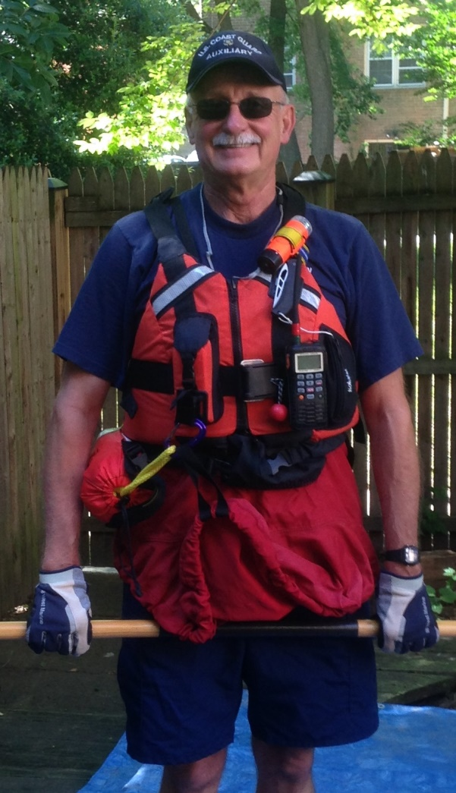
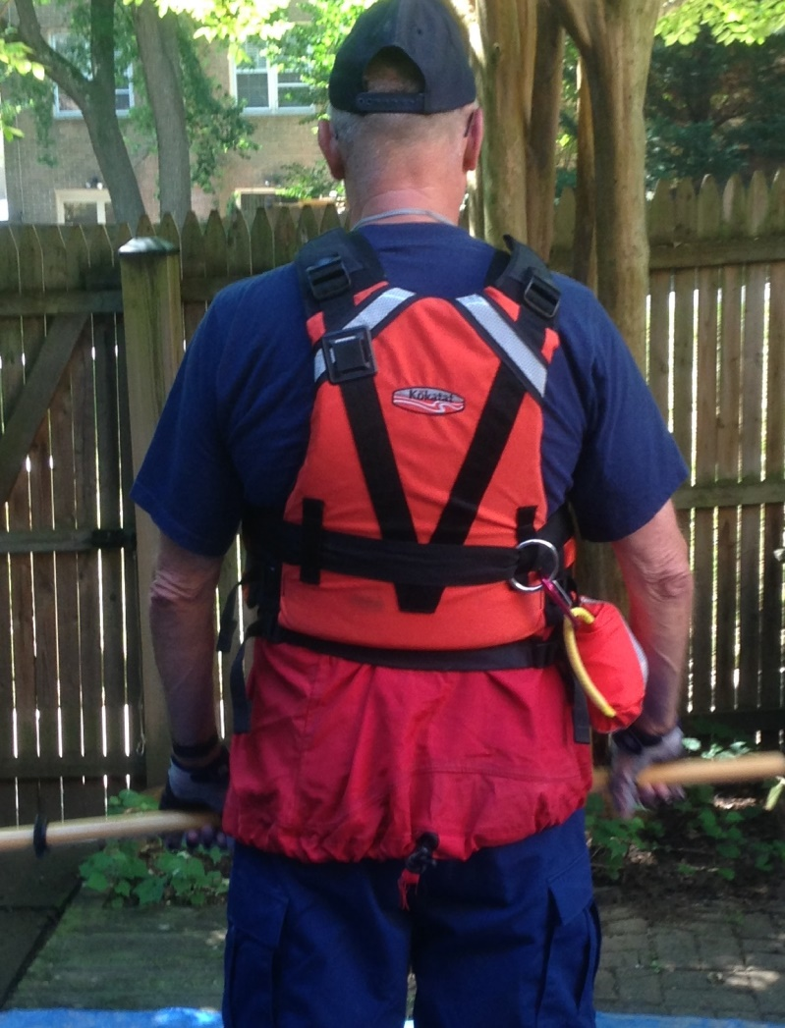
Gear on PFD

Slide 22
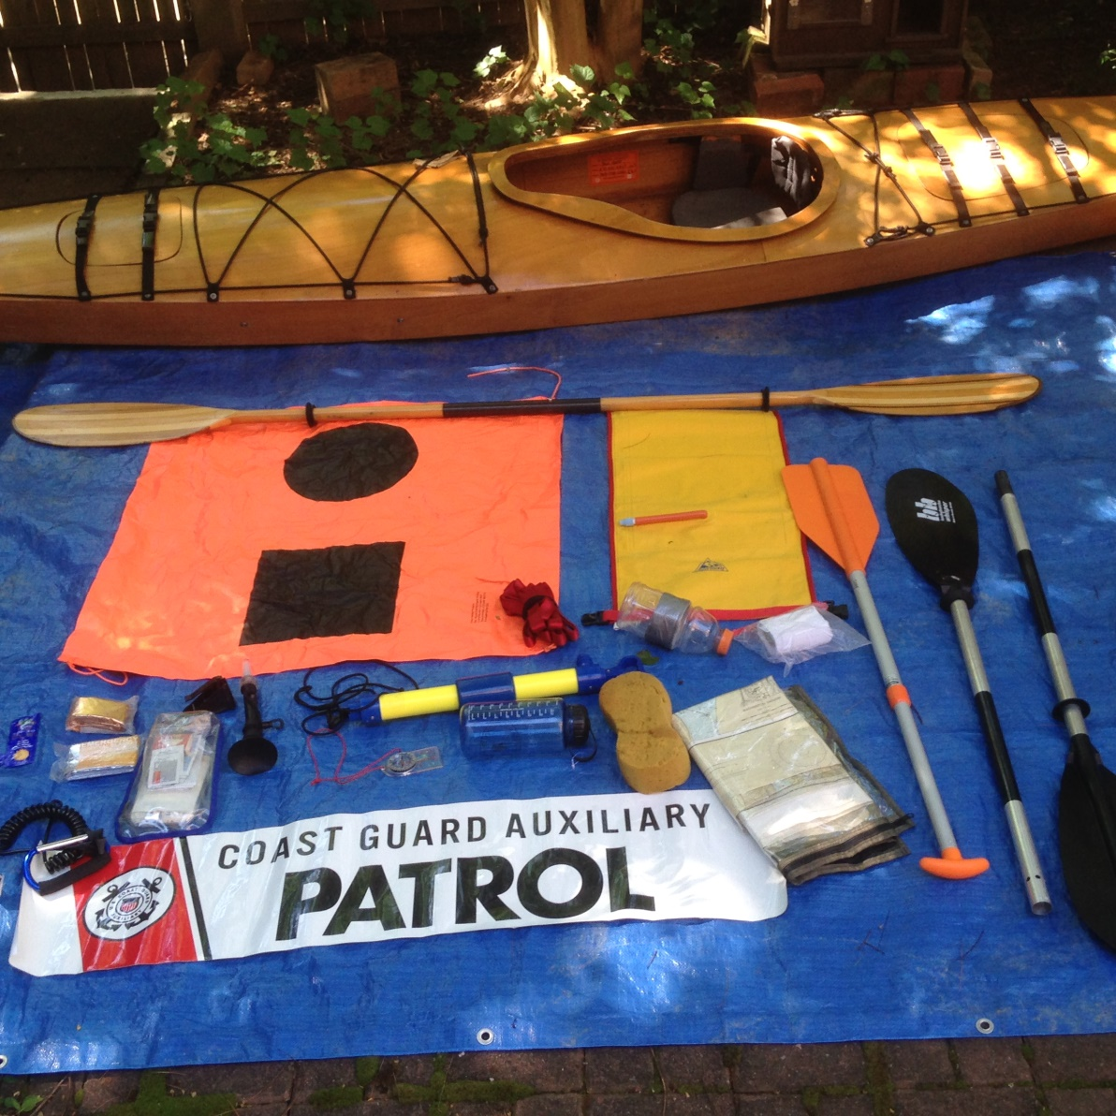
Kayak Gear

Slide 23
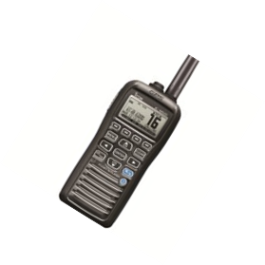
Additional Requirements, D5
Navigation Rules exam
ICS 210 or 300 course
Demonstrate Proficiency Operating Handheld GPS
Specific tasks from BCM and Coxswain tasks

Slide 24
AOMS
When submitting orders within AOMS, AUXPAD operators shall note in the comments section the Auxiliary operational vessel facility (boat or personal water craft), a Coast Guard boat, a law enforcement/public safety agency boat, or another AUXPAD facility to meet the tandem operating requirement. This additional information is in addition to all other OIA AOMS requirements.

Slide 25
Other Resources
A collection of current web site links is available at the Coast Guard Auxiliary site:
http://tinyurl.com/AUXRBS
http://tinyurl.com/paddlecraft-safety
http://tinyurl.com/AUXPAD
http://auxbdeptwiki.cgaux.org/index.php?title=Paddlesports This collection includes links to instruction, clubs, and information specific to paddlers’ needs in text and video formats
The American Canoe Association website is at:
http://auxbdeptwiki.cgaux.org/index.php?title=Main_Page This site will help you find skills instruction
Notes:
Link to Coast Guard Auxiliary collection of web sites with information for paddlers.
Link to the ACA website for information about skills instruction

Slide 26
Contact Info
Don Goff, Senior Advisor for Paddlecraft Safety
Don.Goff@cgauxnet.us
571-216-3827
Join the MyCGAUX Community of Interest
Look under Recreational Boating Safety—
and “friend” me

Slide 27
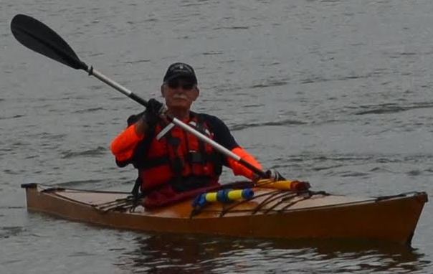
Have Fun, But Be Safe!

