Slide 1
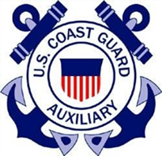
Paddler’s Guide to Safety Train the Trainer
N-TRAIN 2017
Don Goff
Senior Advisor for Paddlecraft Safety

Slide 2
Resources
PE PowerPoint slides and Instructor’s Guide
Available at the CG AUX E Library at: http://wow.uscgaux.info/content.php?unit=E-DEPT&category=paddlers-guide
COMMANDANT INSTRUCTION 16794.11 AUXPAD Program
Available at: http://www.uscg.mil/directives/ci/16000-16999/CI_16794_11.pdf

Slide 3
AGENDA
Course Overview
Needs
Course Materials and Special Features
Flexibility
“Bumper Stickers”
Resources

Slide 4
AUXPAD Purposes
The primary mission of the Auxiliary Paddle craft (AUXPAD) program is to:
Extend boating safety outreach,
Promote life jacket wear
Promote operator compliance with Coast Guard required safety equipment within the paddle craft community.

Slide 5
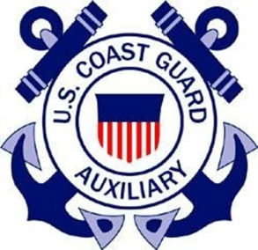
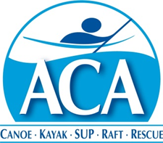
A Paddler’s Guide to Safety
Presented by the U.S. Coast Guard Auxiliary in cooperation with the American Canoe Association
Notes:
The objective for this course is for you to be aware of the basic issues and needs for paddling safety, the basic equipment you should have, and to provide some info about paddling that will help you be a more knowledgeable and safer paddler.

Slide 6
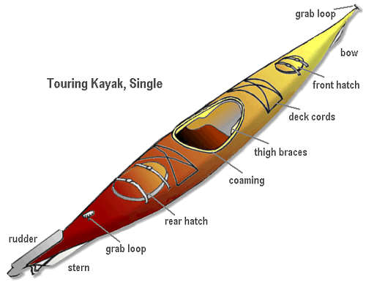
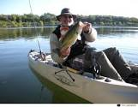
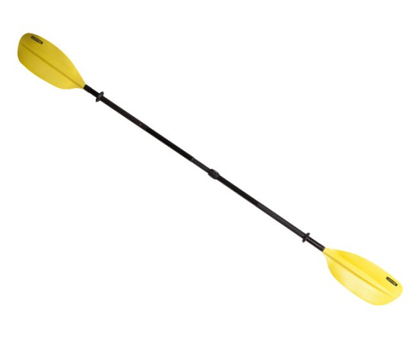
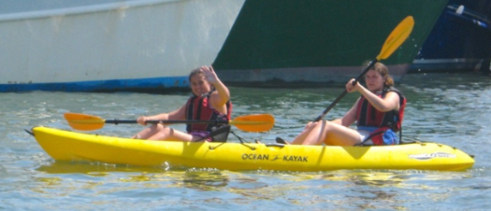
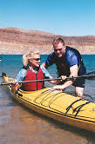
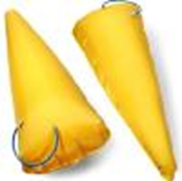
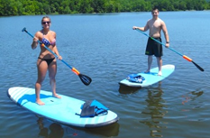
Starting Out – Basic Paddlecraft and Equipment
Notes:
The Boat
* Match the craft to the paddler and the desired activity
*basic boating terms (beam, length, freeboard, and their impact on function)
*kayak (touring vs. whitewater vs. rec boat, sit in vs. sit on top)
*SUP
*canoe (touring vs. whitewater, solo vs. tandem)
* Follow manufacturer’s guidelines for boat use and care (basic maintenance)
* Don’t overload the boat
* Take care of the boat – keep it clean, check for hull and hardware integrity, and make sure any damaged parts are repaired before heading out
The Paddle
* Match the paddle to the paddler and the desired activity
*canoe and SUP paddles are single bladed, kayak paddles are double bladed
* review paddle terminology (grip, shaft, throat, blade, tip, feather)
* Follow manufacturer’s guidelines for paddle care and use
* Avoid grinding the blade into the ground and avoid using the shaft for prying things
Flotation
* Most boats have minimum flotation when purchased--this flotation only creates neutral buoyancy.
* Add inflatable or cell flotation to displace water and decrease the amount of water that could come in when you capsize. This is probably your most important investment after the boat, paddle, and life jacket.

Slide 7
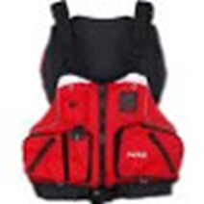
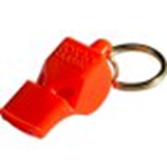
Life Jackets
USCG-approved Life Jacket
May be inflatable
Should be worn
Wear is required for certain ages, conditions-check locally
“Sound device”—a whistle—attached to the Life Jacket
Notes:
The lifejacket (PFD or personal flotation device)
* Properly rated (according to weight) USCG approved lifejackets are required for every person in the boat, and should be worn by everyone whenever they paddle
* Lifejackets need to be fitted and adjusted appropriately
* Bright colors such as red, yellow, or orange enhance visibility and are preferred over blue, olive, or camo on mixed use waterways
* Match the lifejacket to the paddler and the desired activity
* Capsizes and falls overboard are common among paddlers – wearing a lifejacket dramatically reduces the risk of injury or death during such an event
*Lifejackets not only reduce the risk of drowning, they also can provide protection from rocks and other debris in rivers, provide a place to store critical emergency equipment (e.g., whistle, signal mirror, light), and can help keep paddlers warm.
* Inflatable lifejackets should only be orally or manually inflatable—not “automatic”.

Slide 8
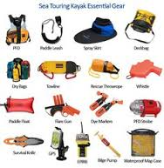
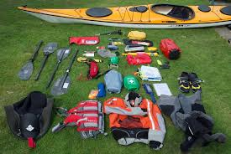
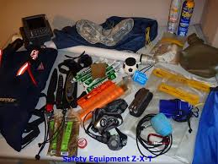
Other Equipment
Notes:
Other equipment to consider bringing
* Wear clothing designed for weather and water conditions—visible colors!
* Bring adequate food, water, and extra clothing. Fill the bottle half way so it floats and is easy to see —full may be more difficult to see due to neutral buoyancy
* Use clothing and equipment (e.g., hats, sunblock, extra clothes) to reduce the risks of environmental problems such as hypothermia and sunburn
* Match extra gear (e.g., helmets, radios, flotation bags, spare paddles, navigation tools) to the paddler, the group, the environment and the desired activity
* Carry appropriate rescue gear and learn how to use it
* Navigation lights, distress signals and sounds signals may be required. Check with your local state boating officials to find out what you need to carry with you. Every paddler should have a whistle attached to their lifejacket.
* Printed pre-underway checklist
* Pen or pencil
* Notebook/logbook
* Sponge and/or manual pump for dewatering
* Other gear needed for safe operation and self-rescue of the particular type of paddle craft: e.g., paddle float, paddle leash, spray skirt
* Drinking water
* Visual Distress Signals (VDS)
*Bow line and/or stern line (“painter”) to tie up along a dock or ashore
* Label or Nameplate affixed to interior of vessel, identifying Owner and "if found" phone numbers
* In coastal waters, one waterproof VHF marine radio or portable VHF radio in clear plastic waterproof bag.
* Watch, (waterproof)
* Cell Phone in waterproof container as backup
* Flashlight or Headlamp
* Flotation foam or bags sufficient to permit self-rescue
* GPS
* Compass, hand-held or mounted
* Rescue throw bag (smaller size for paddle craft, 30' max recommended)
* Spare paddle/oar
* First Aid Kit
* Emergency survival blankets (2) "space blankets"
* Chart of Local Area
* Repair equipment such as extra rudder cable, spare foot peg, drain plug
* Additional rescue gear specific to your trip
Be sure to securely attach everything to your boat so nothing can float away after a capsize!

Slide 9
Legal Requirements
Boater Education—not required for paddle craft
Boat registration—varies from state to state; go to http://www.americasboatingcourse.com/lawsbystate.cfm to find your state.
Your dealer should know.
Notes:
Registration and education
Boat registration and education laws vary from state to state. Make sure you know the requirements that apply in the area you’re paddling.
Check the specifics for your state at: http://www.americasboatingcourse.com/lawsbystate.cfm
Local rules
* Be sure to learn any rules or laws that apply to access and use of a waterway.
* Obey all applicable local, state and Federal regulations
* Boats with motors or sails have requirements that can be very different from hand powered craft – be sure you know what your boat requires
Operator responsibilities
* Boaters are responsible for their actions. Be polite and respectful of others on and around the water.
* Avoid large vessels and navigable channels, where large boats may have restricted mobility
* Stay well away from military and law enforcement vessels unless they direct you to approach
* Follow all marine and aquatic environmental laws – don’t ask others to paddle in your trash
* Invasive species transfer

Slide 10
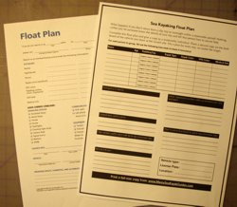
Trip Planning
Notes:
C. Planning your trip
Anticipated destination
* Match the paddler’s skill with the planned destination – it is important for new paddlers to be conservative and choose paddling venues with minimal hazards
* Check for weather and water conditions
* Learn about local hazards
* Learn about access points
* Have a back up plan
* Develop and file an appropriate float plan for your trip, describing your route and access points, length of trip, number of people and boats on the trip, when you would be overdue, and what to do if you are overdue.
Equipment
* Make sure you have appropriate equipment for your type of boat and the area you plan to paddle
* Make sure your equipment is in good working order before you head out
* Stow the equipment properly; plan for a capsize
* Make sure you have appropriate charts, maps and directions
Group
* Paddling with a group is safer (3 people / two boat minimum)
* Ensure each group member has appropriate knowledge, skills and equipment for the trip

Slide 11
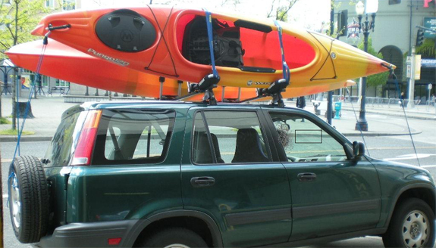
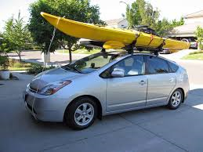
Getting to the Water
Notes:
D. Getting to the water
Transporting and securing your boat:
* Drivers are responsible for the load on, or towed by, their vehicle! If it comes off and damages someone or something, you are liable.
* Use appropriate knots, ropes and straps to secure your boat
* Tie at two points across the beam to secure to the rack, tie bow and stern to secure to vehicle (4 point tie down is best)
* Ensure nothing can blow out during transport
* Use appropriate racks or trailers for your boat
* Consider using locks to secure your boat
* Shock cord or other stretchy material is not adequate—use stout line (rope) or locking straps

Slide 12
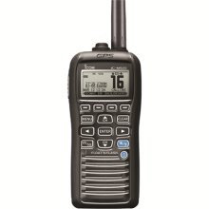
At the Water’s Edge
Check equipment again-use a check list instead of memory
File your float plan
Clarify your group communications with each other and with backups
Notes:
E. At the water’s edge
Equipment
* Make sure everyone has appropriate safety and protective equipment, including a life jacket that is being worn and used appropriately.
* Make sure that everyone’s boat, paddle, lifejacket and additional equipment is in good working order before setting out—look for cracks, holes, tears, other damage.
* Appropriately secure all equipment in the boat, both so the boat is properly balanced and to ensure equipment is not lost during a capsize.
Navigation
*Make sure everyone knows the planned route
* Make sure that, if needed, some type of shuttle is set
* Make sure everyone understands navigational markers in the area in which they will be paddling (e.g., channel markers, dam warnings, restricted areas)
* Make sure everyone understands any potential “no-boating” areas, such as security areas around military vessels
* Avoid navigable channels and stay as close as feasible to shore; when crossing channels spend as little time as possible in them
* Human propelled vessels generally have right of way over power and sail; power and sail vessels have more maneuvering restrictions and are much slower to stop. Despite having right of way, it’s best to take steps to avoid collision or near miss—remember—they are bigger and heavier and will always win in a collision. You are small and may be invisible to a commercial vessel
* Review hand and arm signals
* Test radios or phones and ensure they are waterproofed
* Learn the sound and visual signals, especially 5 short blasts for Alert! or Emergency!
* Some paddlesports such as American Whitewater’s signals for whitewater rivers have their own whistle and signal language. Learn these if necessary.

Slide 13
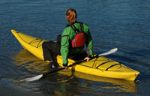
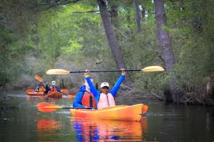
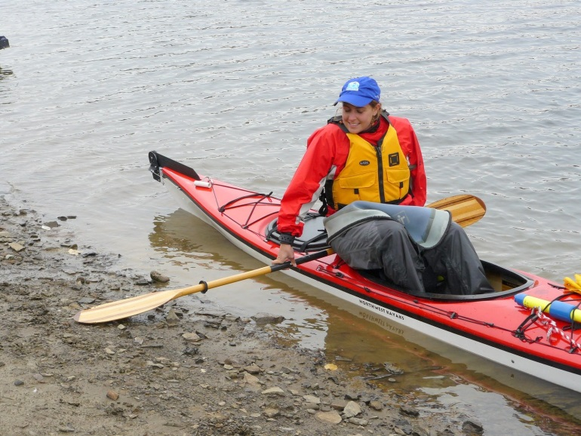
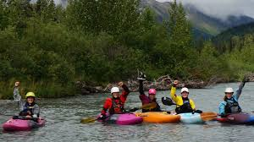
On the Water
Notes:
F. On the water
Boarding, exiting and moving about the boat
* Don your life jacket before boarding, and keep it on all the time during the paddling trip
* When boarding or exiting a boat, keep weight low, and move slowly to reduce the risk of capsize
* Maintain at least 3 points of contact when boarding, exiting, or moving about the boat
* Avoid switching positions once away from shore. If you do move, use good principles (such as moving one person at a time, moving slowly, moving along the centerline and maintaining a low center of gravity).
* Avoid sudden movements in the boat
Paddling
* Paddling in groups of three or more is generally safer
* Do not use drugs or alcohol either before or while on the water
* Boat politely – look out for yourself and everyone else on the water
* Boat conservatively – stay within your skill level
* Hands-on instruction makes paddling safer and more fun
Other activities
* Anglers and hunters should be extra vigilant about weight shifts, appropriate equipment, and lifejacket use
* Animals should use properly fitted lifejackets
* Anticipate sudden movements from animals in boats

Slide 14
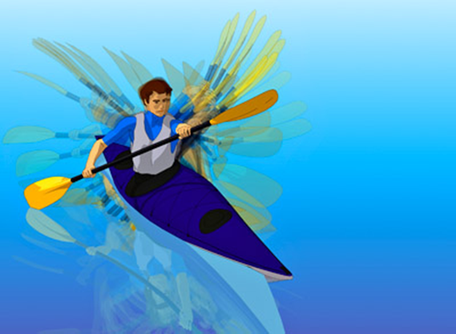
Visibility
Paddle Flash
Motion
Clothing
Notes:
Visibility
* Maximize your visibility through color and contrast
* Bright clothes, lifejackets and boats are easier to see
* Carry a bright white light if there is any chance you may paddle at night
* consider carrying bright or reflective flags to increase visibility
*Your paddle will glint—that will be the first thing an oncoming boat is likely to see. Second is the motion of the paddle. The paddler is third.

Slide 15
Closing Distance
¼ Mile
Response times:
@60 mph—15 seconds
@45 mph—20 seconds
@30 mph—30 seconds
Notes:
At one quarter of a mile—the distance a boater is apt to first see a paddler, the reaction time is proportional to speed. Increase your visibility to reduce your risk.
Be aware of boat traffic and stay to the right side or away from the main channel as much as possible.

Slide 16
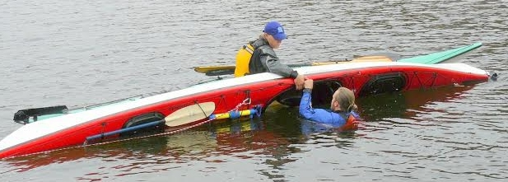
Emergencies
Weather-related
Human-induced: alcohol and drugs
Accidents or illness
Practice your self and team rescues--regularly
Notes:
G. Emergencies
Avoid problems
* The best rescue is the one that is prevented
* Check water and weather conditions, and be flexible when what you expect doesn’t match what you find
* If bad weather or water conditions are forecast, wait for better conditions
* Use knowledge, skills, abilities and equipment to avoid problems, and to reduce the impact of problems when they happen
* Alcohol and illicit drugs have no place in paddling. Consider the effect of medications – some medications may affect your judgment or make you drowsy, others may increase your sensitivity to sunburn or dehydration
Manage problems
* Capsizing and falls overboard are part of paddling – learn how to manage them when they happen
* Cold water shock is a major factor in boating fatalities. It happens when someone is suddenly immersed in cold water. The water does not have to be freezing; cold water shock often occurs in water temperatures above 50°F. The body's first response to cold water shock is usually an involuntary gasp (torso reflex).
* Conditions that can lead to hypothermia (abnormally low body temperature) are common when paddling – learn how to prevent and treat it. *Recognize that hypothermic paddlers may be unable to help themselves. Recognize that good judgment is one of the first things lost in hypothermia.
* Conditions that can lead to hyperthermia (abnormally high body temperature) and dehydration are common when paddling – learn how to prevent and treat them
Boaters depend on each other – learn how to help other boaters and make sure you have appropriate rescue knowledge, skills and equipment

Slide 17
After the Problem
Accident reports—forms and instructions are available on the ACA and USCG apps, as well as reporting requirements
Check for additional local rules
Notes:
After the problem
* Accident reports are required anytime a fatality occurs, a person has to go to the hospital, the boat is lost, or significant property damage occurs
* Check with your state boat law administrator for state specific rules
Accident reports should be made to the local state boating law administrator
Coast Guard form on CG and ACA Apps or at: https://www.uscg.mil/forms/cg/CG_3865.pdf

Slide 18
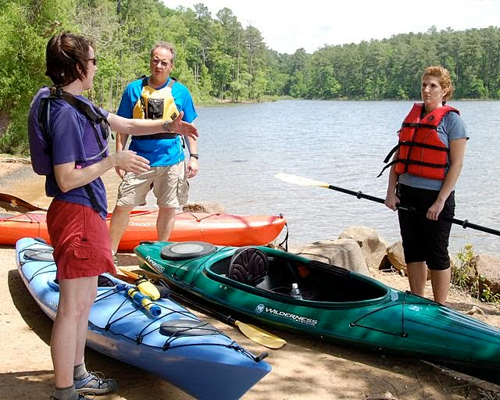
After Your Trip
Had fun?
Plan to do it again
Keep learning
Clean, repair and protect your gear
Notes:
G. After your trip
Keep learning and paddling
* Local clubs and schools, and local paddling shops, are a great resource for paddling information and for paddling partners
* Regional and national programs can help you find a local instructor
*ACA’s website provides lists of instructors and clubs, and lists of water trails
* Paddlesports are a lifelong activity
Take care of your gear
* After your trip, clean and store your equipment appropriately. Avoid phosphate containing soaps and avoid transporting aquatic plants and animals
* Check your gear to make sure it is still in good working condition
* Repair any damaged gear before you need to use it again

Slide 19
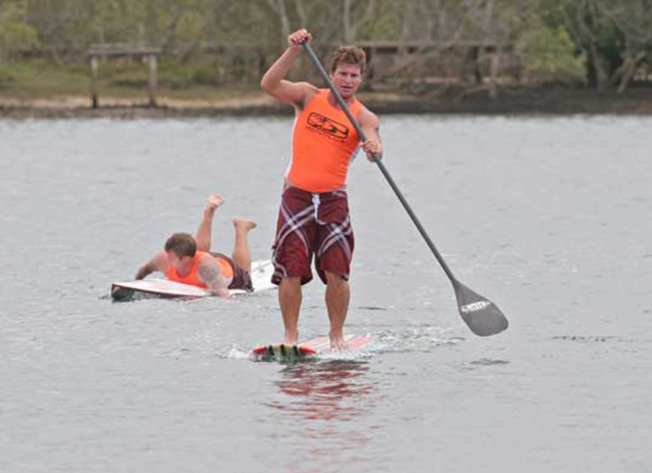
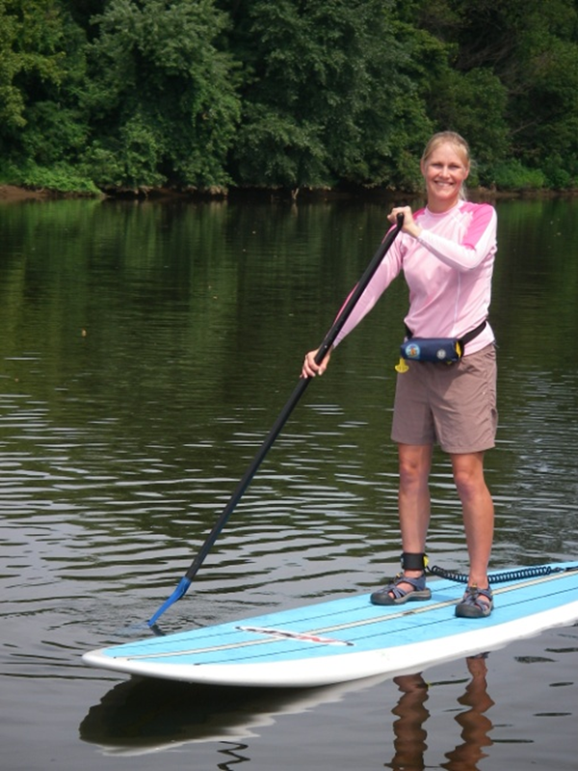
SUPs
Notes:
SUPs
Stand Up Paddleboards-SUPs-are legally vessels. Operators must have a life jacket aboard EXCEPT in a surf zone. Inflatable lifejackets are commonly used.
The paddler on the left is using a board too small for his weight. He has no (required) life jacket. Despite the rocky shore, he has no suitable footwear.
The woman on the right side has the right size board, is properly wearing an inflatable life jacket, has on suitable footwear, and has a leash that attaches her to the board by way of her right ankle. Ankle leashes are useful, but not for surf, swift currents, or conditions where being tied to the board could prove dangerous—situational decision making applies. Learn what types of leashes and lifejackets are appropriate for different water venues. For more information play the video at: http://www.americancanoe.org/?page=SUP_PSA

Slide 20
Top Ten Safety Tips for SUPs
1. Wear a lifejacket and carry a whistle
2. Be a competent swimmer
3. Know how to self rescue
4. Know how to tow another board
5. Know the local regulations and navigation rules
6. Understand the elements and hazards – winds, tidal ranges, current, terrain
7. Know when to wear a leash
8. Be defensive – don’t go where you aren’t supposed to be and avoid other swimmers, boaters, paddleboards
9. Use proper blade angle to be the most efficient paddle boarder
10. Take a safety course - See more at: http://coastguard.dodlive.mil/2012/05/top-10-tips-for-stand-up-paddleboarding/#sthash.YuqM93S4.dpuf
Notes:
Top Ten Safety Tips for SUPs
1. Wear a lifejacket and carry a whistle
2. Be a competent swimmer
3. Know how to self rescue
4. Know how to tow another board
5. Know the local regulations and navigation rules
6. Understand the elements and hazards – winds, tidal ranges, current, terrain
7. Know when to wear a leash 8. Be defensive – don’t go where you aren’t supposed to be and avoid other swimmers, boaters, paddleboards
9. Use proper blade angle to be the most efficient paddle boarder
10. Take a safety course - See more at: http://coastguard.dodlive.mil/2012/05/top-10-tips-for-stand-up-paddleboarding/#sthash.YuqM93S4.dpuf

Slide 21
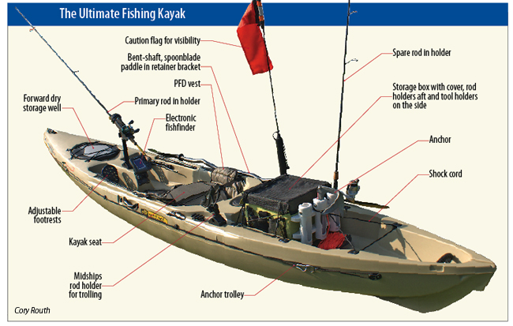
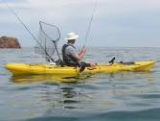
Kayak Fishing
Notes:
Kayak fishing
Fishing alters your trim—bringing in the Big One will challenge your balance and can pull you in—practice—and wear your life jacket
Anchoring
Anchor from the bow, not the cockpit. Kayak anchoring requires some special equipment and knowledge to learn.
Take an empty bottle to relieve yourself. Mark it with duct tape so you don’t confuse it with your water bottle.
Lines in the water, and gear on deck, can make it difficult to re-enter the boat. Hooks and lines in the water also can make swimming around the boat dangerous.

Slide 22
Top Ten Safety Tips
1. Take an On-Water Skills Course
2. Wear Your Lifejacket
3. Cold Water and Hot Weather Safety
4. Rules of the Road
5. Safety Check
6. Practices, Ethics and Conduct
7. Know Your Limits
8. River Paddler's Guide to Rescue - The basics, just in case...
9. Best Practices for Paddlers and Paddlesports Programs
10. Trip Preparation and Planning
Notes:
1. Take an On-Water Skills Course - whether it's a safety or skill development course, an instructor-led on-water instruction course provides the information you need for canoeing, kayaking, stand up paddleboarding, rafting or safety & rescue.
2. Wear Your Lifejacket - Expect to capsize and swim occasionally when paddling a canoe, kayak, SUP or raft? Learn more about PFDs and how they might just save your life.
3. Cold Water and Hot weather Safety - Cold water is extremely dangerous! Heat stroke can be fatal. Learn the essentials of on-the-water temperatures and first aid. Learn more about protecting yourself in this environment
4. Rules of the Road - What paddlers need to know when sharing the waterways
5. Safety Check - Safety tips you need to consider the next time you head out on the water
6. Practices, Ethics and Conduct - Key points on how to appropriately share, and enjoy our natural paddling resources: https://c.ymcdn.com/sites/aca.site-ym.com/resource/resmgr/sei-educational_resources/brochure_practices-ethics-co.pdf
7. Know Your Limits - Good things to contemplate before you leave shore
8. Learn and Practice Essential Rescue Skills
9. Learn and Practice Best Practices for Paddlers and Paddlesports Programs: https://c.ymcdn.com/sites/aca.site-ym.com/resource/resmgr/sei-educational_resources/brochure_best_practices.pdf
10. Trip Preparation and Planning - Getting ready to schedule your next trip? File a Float Plan
Learn and Practice Essential

Slide 23
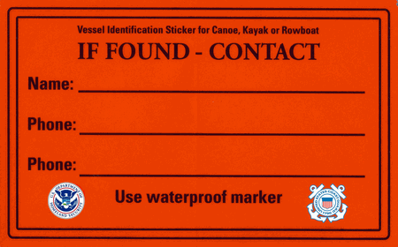
Put your name and your home telephone number on your boat!
John Doe
Home phone
Another phone-spouse cell
If you had your cell phone in the kayak, it won’t work wet!
Notes:
You need to put you name and a contact phone number on your boat in case it blows or floats away—or in case you are overboard. Use an indelible marker, a paint stick, or nail polish so it doesn’t wash away. Place the sticker in a prominent location. Inside the gunnel on the starboard side is a good location. They may fade if they are put on the deck.
With this information, first responders will call and determine you are safe or they need to search for you.
If you can’t get a printed form, use a piece of duct tape and an waterproof marker. Anything is better than nothing.

Slide 24
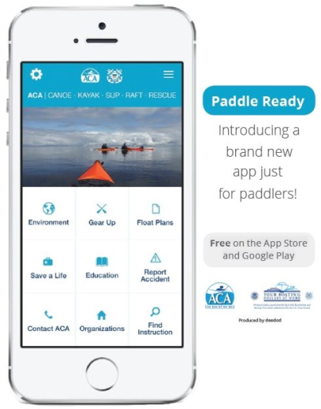
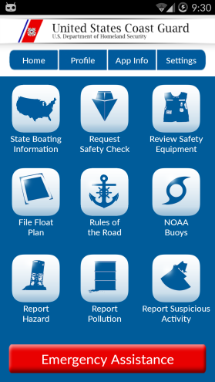
“Smart” Resources
These Apps are available for free in iOS or Android format from your Apps Store:
ACA’s Paddle Ready Coast Guard Recreational
Boat Safety
Notes:
Both of these apps are available for either Android or iOS at the App Store.
The ACA app “Paddle Ready” app includes the following functions (version 1.0):
* Environment
* Gear
* Float Plans
“Save a Life” – detailed information about life jackets and other safety gear
* Education—
Signs and Signals
How to Rescue
* Accident Report Form
* ACA contact—phone, email, or snail mail
* Organizations—Paddling clubs and groups by state
* Instruction finder—Zip Code sort to locate an instructor for your specific paddling discipline and geographic area
U.S. Coast Guard Safe Boating app includes the following functions:
* Emergency Assistance direct contact capability (requires registration)
* State Boating Information
* Safety Check Request (yes, paddle craft can have a vessel safety check)
* Safety Equipment review (generic)
* Float Plan (form)
*Rules of the Road
*NOAA buoys – these give current conditions of wind and water. Temperatures. Directions.
* Hazard Report procedure
*Pollution Report procedure
*Suspicious activity report

Slide 25
Paddle Sport Participation
The 2015 Special Report on Paddlesports shows paddlesports are on the rise, again setting a record for the number of participants.,
In 2014, 21.7 million Americans — 7.4 percent of the population — enjoyed paddling.
This represents an increase of more than 3 million participants since the study began in 2010, 14% more.
(source: The Outdoor Foundation)
Notes:
Paddle sport participation has grown dramatically in recent years. Low entry cost, easy storage, less maintenance and flexibility are reasons many have decided to become paddlers, compared to power or sailing craft.

Slide 26
“Boats in Aisle Five”
Most boats are now sold by retailers who are not paddlers
Most boats are sold without any instruction or guidance
Notes:
In the past, would-be paddlers often went to specialty stores to get information and advice from retailers who were paddlers themselves.
The majority of boats sold now come form general merchandisers and “big box” outlets whose staff are not particularly knowledgeable about the details of the sport.
In addition, the safety equipment offered for sale may be generic rather than specific to the location.

Slide 27
Registered Vessels and Deaths 1962-2014
Notes:
Since the early 1960’s when the Coast Guard began tracking recreational boating accidents, overall, fatalities have come down both in percentage and real terms for power boats.
The number of registered vessels has increased. (green line)
A linear projection of fatalities using the 1962 numbers shows nearly 3000 deaths could have been expected in 2010 (red line)
Public awareness and PE classes have contributed to a dramatic reduction in the actual outcome (blue line)
Registered Vessels and Deaths 1962-2014

Slide 28
Paddle Sports Deaths
Notes:
Unlike power boats, with the growth in paddle sports, the number of fatalities has gone up.
In the most recent reporting year, 2014, 22% of boating deaths were paddlecraft related.
28
28

Slide 29
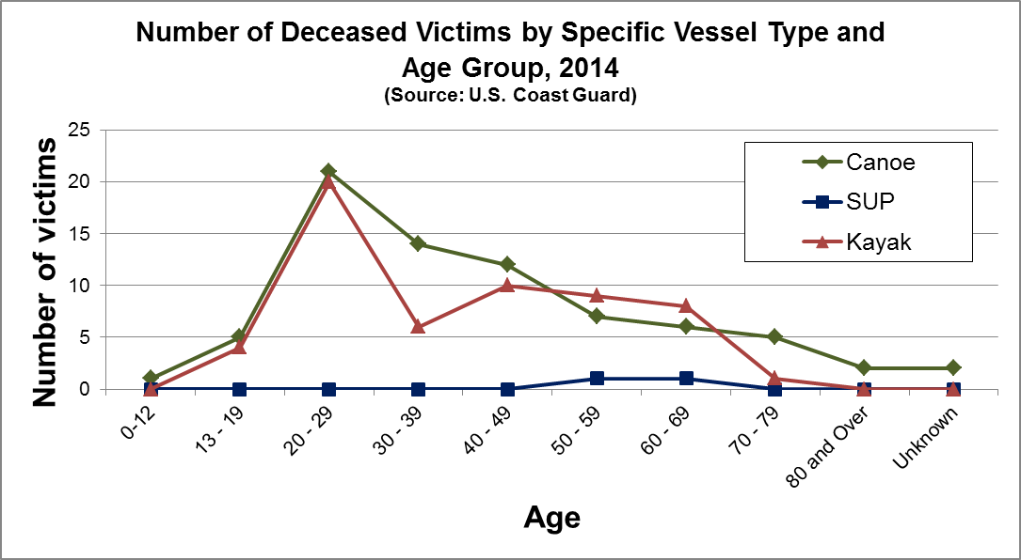
Notes:
We have a done a fair job protecting youth, according to these figures from 2014.
We might expect young men, especially those using alcohol, to have a relatively high rate.
But these figures show that paddlers over age 50 are dying as well as younger paddlers.

Slide 30
All Fun, but….
Notes:
Risks are always at hand when you are on the water.
Our hope is that you learn about paddling so you can stay safe and have fun on the water.

Slide 31
Other Resources
A collection of current web site links is available at the Coast Guard Auxiliary WIKI links site:
http://auxbdeptwiki.cgaux.org/index.php?title=Paddlesports This collection includes links to instruction, clubs, and information specific to paddlers’ needs in text and video formats
The American Canoe Association website is at:
http://auxbdeptwiki.cgaux.org/index.php?title=Main_Page This site will help you find skills instruction
Notes:
Link to Coast Guard Auxiliary collection of web sites with information for paddlers.
Link to the ACA website for information about skills instruction

Slide 32
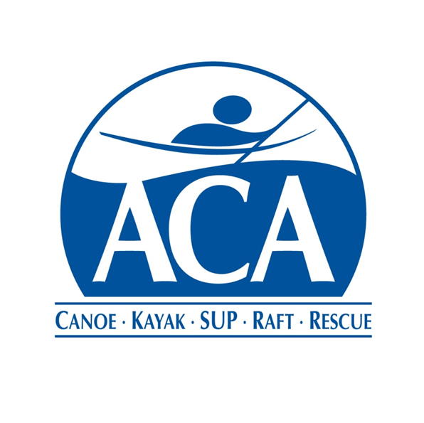
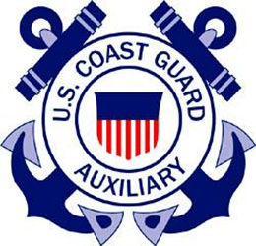
The American Canoe Association and the U.S. Coast Guard Auxiliary signed a Memorandum of Agreement in 2011 to promote safety among those who use kayaks, canoes and other paddle craft.
Notes:
In 2011, the Auxiliary and the ACA completed a Memorandum of Agreement to work together to promote paddle sport safety. General provisions include:
Fostering a partnership between the Auxiliary instructors and vessel examiners and their counterparts in the ACA.
Establishing local contacts with each other
Enhancing the paddlesports education experience
Identify and share resources as needed.
Formal (institutional) interactions through Auxiliary liaisons to the ACA and National Safety Education and Instruction Council (SEIC).
Shared use of media resources of the ACA and the Auxiliary to raise safety awareness.
“But the ACA has been around since the 1880s and the Coast Guard since 1915, so why the sudden interest in paddling?” Growth in participation and an increase in the number of drownings.
The memorandum is available at: http://www.americancanoe.org/?page=Partners Then click on Coast Guard Auxiliary.

Slide 33
Materials and Resources
Locally printable check lists and safety tips
Side bars with “sea stories” and details for the instructor to use to illustrate the points
Links:
http://tinyurl.com/AUXRBS
http://tinyurl.com/paddlecraft-safety
http://tinyurl.com/AUXPAD
Notes:
The appendix in the Instructor’s Guide provides printable check lists to hand out to students and the top ten safety tips for both kayaks and SUPs.
“Sea stories”, that is, stories about kayak safety incidents are included to give the instructor specifics to share with students
Internet links to the Commandant Instruction, the AUX “B” Wiki and the American Canoe Association web site are included.
The RBS web page contains a wealth of AUXPAD program materials and information, including downloadable brochures, PowerPoint materials, and manuals.

Slide 34
Bumper Stickers
Wear your life jacket!
Pay attention to what is happening around you!
Be visible!
Communicate!
Notes:
Wear your life jacket!
Pay attention to what is happening around you! (situational awareness)
Be visible! (clothing and equipment
Communicate! With each other in your group and with first responders as needed

Slide 35
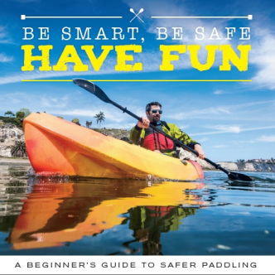
Contacts
Don Goff Don.Goff@cgauxnet.us
MyCGAUX paddlecraft safety Community of Interest (under Recreational Boating Safety!)

